Slide 1
Remote laboratories and mediated interactions: The real opportunity for enhancing learning
Professor David Lowe
Faculty of Engineering and IT
The University of Sydney

Slide 2
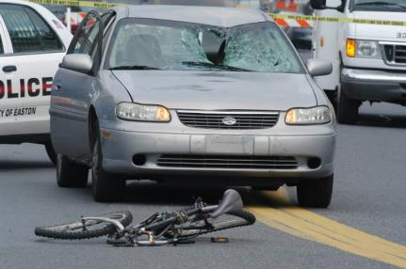
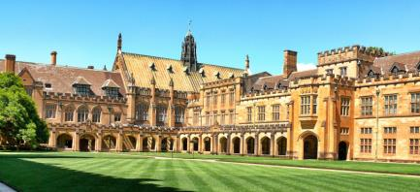
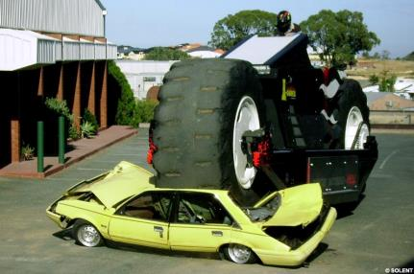
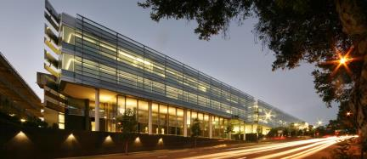
Introduction
David Lowe
Associate Dean (Education)
Professor of Software Engineering
The University of Sydney
Founded 1850
55,000 students, 16 Faculties
16,326km from Munich

Slide 3
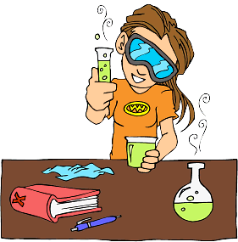
How well can you answer these:
Q: Why do you get your students to undertake laboratory experimentation?
Q: How are the experiments that your students undertaken different from those that might have been carried out 100 years ago?

Slide 4
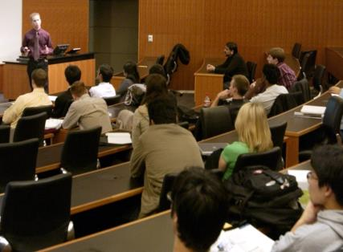
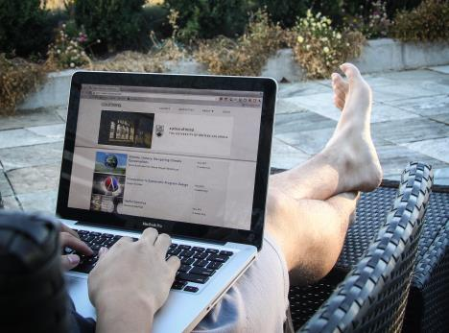
How is University teaching changing?
c1350 class (Laurentius de Voltolina)
c2010 class
MOOCs?

Slide 5
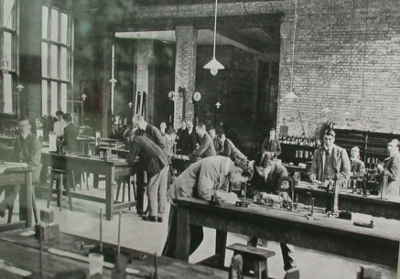
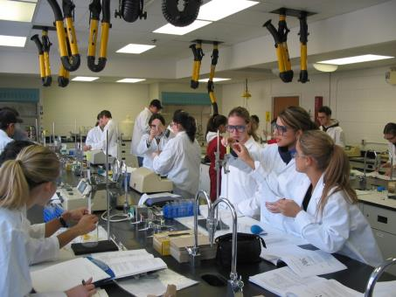
But have we seen similar changes in laboratories?
c2010 Laboratory Typical undergraduate facilities
c1900 Laboratory Cavendish laboratory http://www-outreach.phy.cam.ac.uk/ camphy/museum/area8/display1.htm

Slide 6
But have we seen similar changes in laboratories?
c2010 Laboratory Typical undergraduate facilities
c1900 Laboratory Cavendish laboratory http://www-outreach.phy.cam.ac.uk/ camphy/museum/area8/display1.htm

Slide 7
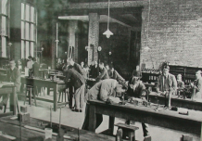
But have we seen similar changes in laboratories?
Lab pedagogy ?
Limited research: ABET taxonomy
Objective 2: Models. Identify the strengths and limitations of theoretical models as predictors of real-world behaviors. …
Objective 3: Experiment. Devise an experimental approach, specify appropriate equipment and procedures, implement these procedures, and interpret the resulting data
…
Objective 13: Sensory Awareness. Use the human senses to gather information and to make sound engineering judgments in formulating conclusions about real-world problems.
from (Feisel and Rosa, 2005)
Lab development ?
Physical labs: tools, data-logging, Usyd xLabs
Simulations
Remote labs

Slide 8
Physical Labs
University of Sydney – CPC XLab

Slide 9
Simulations
www.labster.com (from 2:00)

Slide 10
Simulations
https://www.smartsparrow.com/ (from 2:10)

Slide 11
Simulations
Virtual worlds (0:50)

Slide 12
Are simulations a golden bullet?
Sometimes, but only sometimes?
Consider the “ball race”….
Which ball will reach the end first?
Experiment vs Simulation
Different learning outcomes!
But why? Engagement? Belief?
Sometimes real experimentation is important!
Even further - differences between:
Proximal vs Remote vs Simulations

Slide 13
Remote laboratories
Remote labs allow students to use the internet to remotely access, in real-time, physical laboratory equipment.
The interaction is supported by using sensors and cameras so that the student can monitor the laboratory equipment and actuators so that the equipment can be controlled.
Background
Mid-1990’s – mid-2000’s : Technical challenges
Mid-2000’s – mid-2010’s : Logistical management
Mid-2010’s – … : Educational design
Do they work?
Different modalities suit different learning outcomes

Slide 14
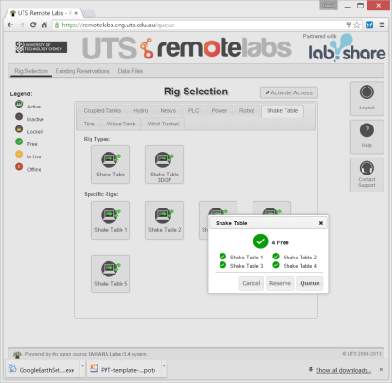
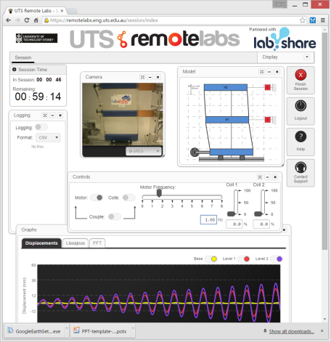
Remote laboratories - examples
https://remotelabs.eng.uts.edu.au/

Slide 15
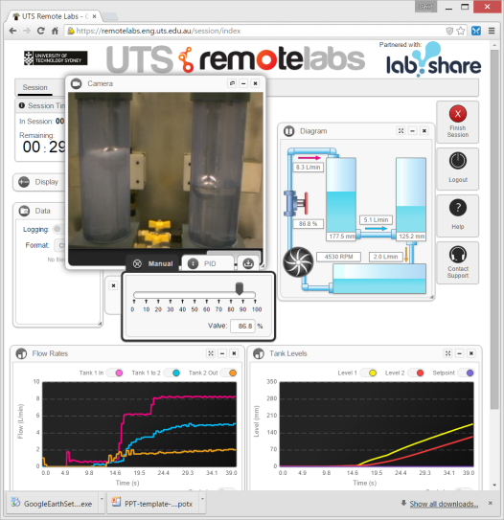
Remote laboratories - examples
https://remotelabs.eng.uts.edu.au/

Slide 16
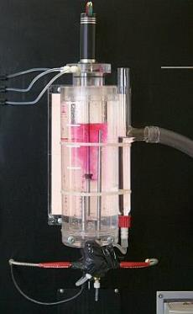
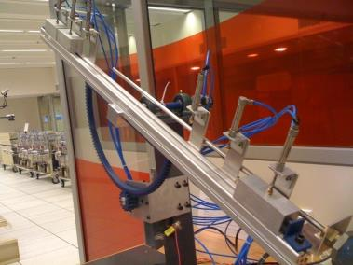
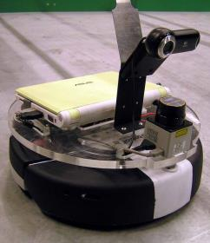
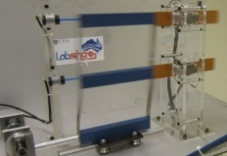
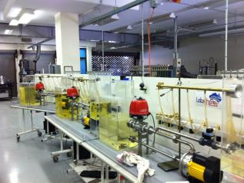
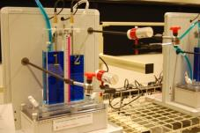
Remote laboratories - examples

Slide 17
Remote laboratories - variations
Interaction timing
Batch vs Interactive
User Access
Direct Access vs Queuing vs Booking
Interaction Type
Monitoring vs Control
Lab Purpose
Teaching vs Research vs Industry
Experiment Location
Lab-based vs Embedded into Industry
Lab Interface
Standalone Client vs Web vs Virtual World vs …

Slide 18
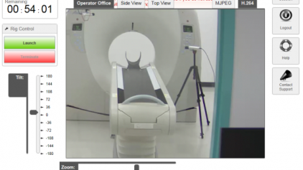
What benefits do the labs provide?
Generation 1: flexible access
Opportunity for better experiences
Improved 'time-on-experiment', more exploration, ...
Generation 2: shared access
Opportunity for better labs
e.g. MRI at USyd
MIT and Africa --> some success
Labshare --> almost no success
Hurdles are still too high?
Generation 3: ???

Slide 19
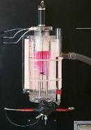
Generation 3: ???
Consider existing remote labs!
Almost all are duplicates of existing facilities
And often constrained versions of them!

Slide 20
Generation 3 : Pedagogic Innovation
Remote laboratories inherently have a mediated interface
Seeing the lab through a lens
How do we use this interface?
Change/extend students' perception of the lab
Doing things that we can't do in conventional labs
Three domains to explore
Augmentation
Adaptation and Access
Collaboration and Gamification

Slide 21
Augmentation: Possibilities
What can we augment?

Slide 22
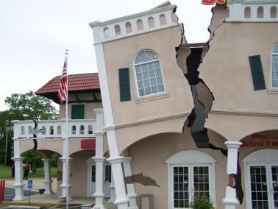
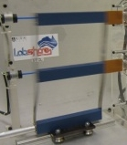
Augmentation: Possibilities
What can we augment?
Providing a context
Ausubel’s “Advanced Organisers”; Novak’s “Cognitive Bridges”; Barab’s “Formalism-Context” relationships, …

Slide 23
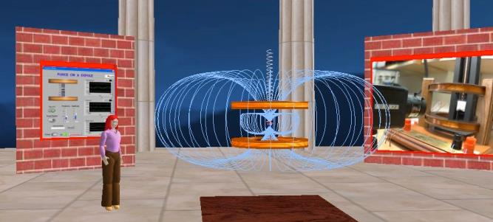
Augmentation: Possibilities
What can we augment?
Providing a context
Making the invisible visible

Slide 24
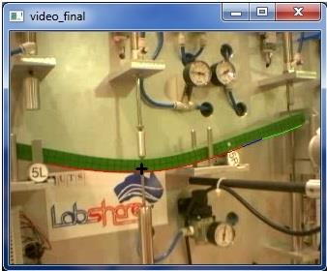
Augmentation: Possibilities
What can we augment?
Providing a context
Making the invisible visible
Making the visible evident

Slide 25
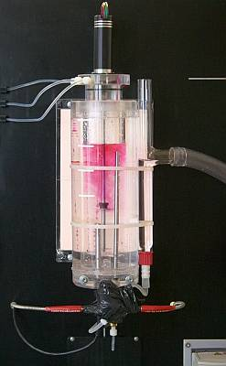
Augmentation: Possibilities
What can we augment?
Providing a context
Making the invisible visible
Making the visible evident
Making the evident obvious

Slide 26
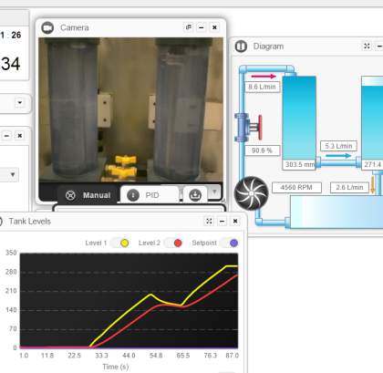
Augmentation: Possibilities
What can we augment?
Providing a context
Making the invisible visible
Making the visible evident
Making the evident obvious
Testing the obvious
L₁(s) = 3.4s² + 2.4s + 3u(s)

Slide 27
Augmentation: Research questions
Does the level of awareness and/or control of the lab 'environment' affect student engagement and hence learning outcomes?
Can augmenting a lab interface result in improved student engagement or learning outcomes?
Can providing students with information on the lab behaviour of other students assist in their learning?
Can outcomes be improved by allowing a student to directly compare their prediction of lab behaviour with actual lab behaviour?
What are the affects on student engagement when they have some control over the nature and extent of augmentation?

Slide 28
Adaptation and Access: Possibilities
What can we adapt?

Slide 29
Adaptation and Access: Possibilities
What can we adapt?
Student guidance:

Slide 30
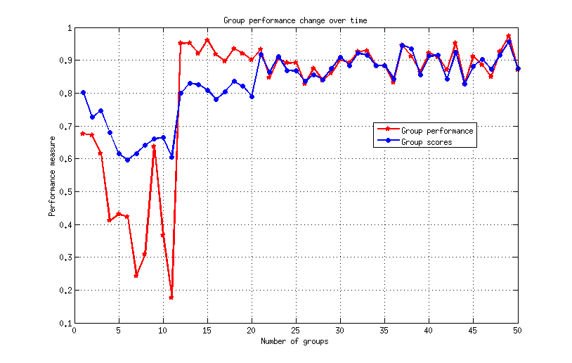
Adaptation and Access: Possibilities
What can we adapt?
Student guidance:
Group formation

Slide 31
Adaptation and Access: Possibilities
What can we adapt?
Student guidance:
Group formation
Automated assessment

Slide 32
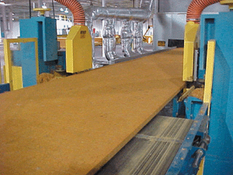
Adaptation and Access: Possibilities
What can we adapt?
Student guidance:
Group formation
Automated assessment
Real-world-embedded labs

Slide 33
Adaptation and access: Research questions
What forms of lab adaptation are feasible for remote laboratories?
How might we undertake automated assessment?
Can we adapt in ways that push students out of their comfort zone? Encourage “making mistakes”?
What level and type of tutor support is appropriate, necessary or helpful in remote labs?
Does adaptation reduce the sense of control, and hence engagement or the reality of the experiment?
Can we develop Industry process monitoring labs? What are the issues associated with remote “lab” access to live data from industrial processes?

Slide 34
Collaboration and Gamification: Possibilities
Support for multi-users
Variable perspectives or roles
Challenges: e.g. Comparison of predictions
MOOLs?

Slide 35
Collaboration and Gamification: Research questions
What is the pedagogic significance of collaboration in labs? In remote labs?
What level of remote interaction is necessary to achieve effective collaborative learning outcomes?
Is immersion counter-productive?
How can we support active engagement from multiple parallel users?

Slide 36
Conclusions
How do we understand experimentation?
We need to rethink the role of experimentation within learning
And where and how it can be carried out
Can we move from: Labs as proxies for the real world?
To: labs as embedded in the real-world?
Can we move from “for this experiment, what learning be achieved”
To: “for these learning outcomes, what are the best labs?”
Are there learning outcomes which were previously not possible in proximal labs, but which are possible in remote labs?
Is there a difference in the relevance of remote labs to Engineering vs Science education?

